Slide 1
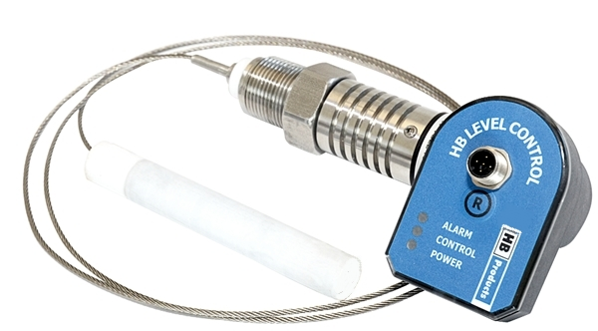
HBLT-wire
Product Introduction

Slide 2
The first ”real” Plug and Play sensor for the industrial refrigeration industry
Plug and play solution.
No dead zone – no calibration – no adjustment to standpipe
4-20 mA linear output or 4-20 mA P-regulation of valve
Alarm output - PNP-NO/NC.
An installation height of only 6” is required.

Slide 3
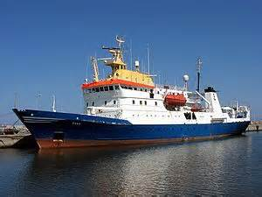
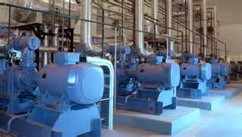
Our goal is to innovate and to push the boundaries of the industry - and now you can reap those rewards!
One sensor works for NH3 or HFC refrigerants. The same sensor can be used in industrial or marine applications.
NH3
HFC

Slide 4
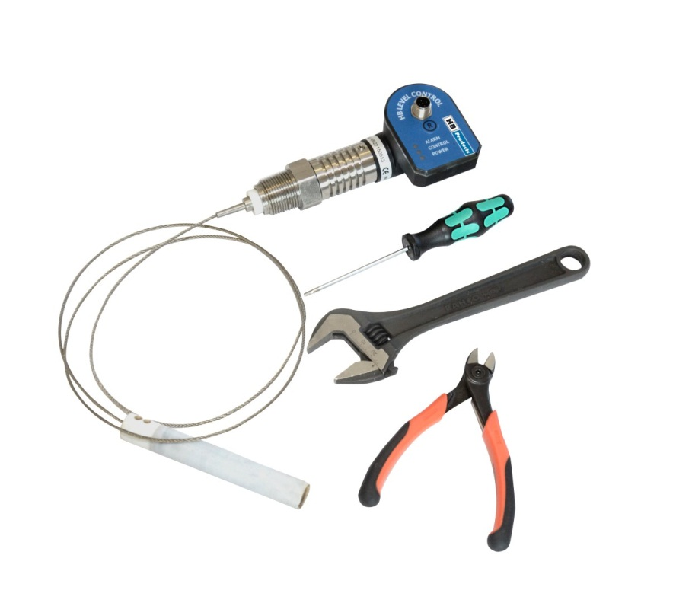
Better, smaller, and more cost-efficient – this is the future of the refrigeration industry!
You can get it:
Cut and configured - free of charge
The ”IKEA” solution – cut it yourself

Slide 5
Cut and configure: Flexible sensor wire, which is adjustable to a length of 300 to 4000 mm
Product features:
Configuration by Windows App: Simple PC configuration for the specified length and refrigerant.
Plug and play. No requirement for recalibration. No requirement for dead zone optimization.
Measures NH3 & HFC refrigerants: R22, R134A, R404A, R410A, R507, R717 & R718).
For marine installations: Can be used for marine applications, since measurement is not affected by contact with the metal surface of the overflow pipe.
Minimum installation height: Requires only 155 mm installation height.

Slide 6
Product features:
Smart split design - makes it easy to install and service. Fault detection on the electronics and/or replacement of the electronics can be carried out without releasing pressure on the system.
No dead zone: Dead zone limited to 0 mm.
Thread size: Available in ¾” NPT and ¾” BSPP.
Alarm: Alarm output can be set in a range from 10% to 100%.
P-regulation: The possibility for direct regulation of modulating valves, pilot valves, or step motor valves.

Slide 7
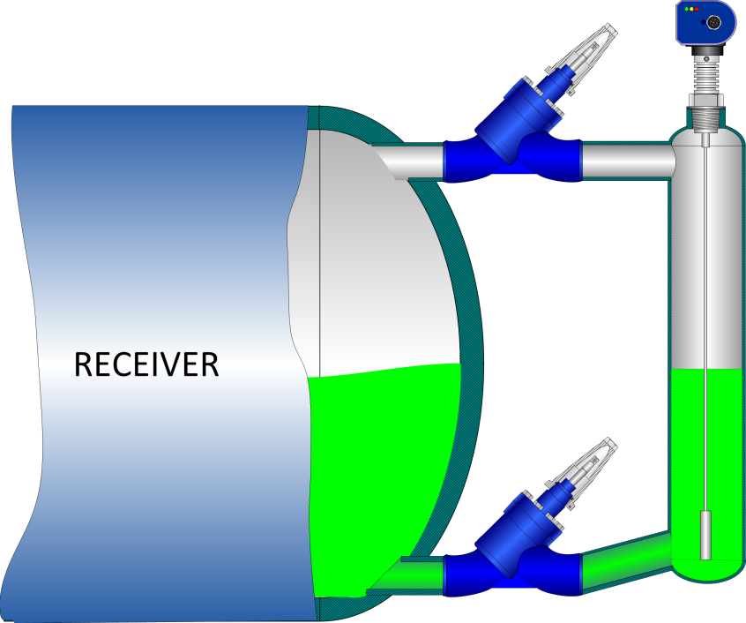
Measuring points:
Programmable alarm point: 10-100 %
20 mA / 100%
Alarm point
4 mA / 0%
Tank linear measurement – 4mA/0% … 20mA/100%

Slide 8
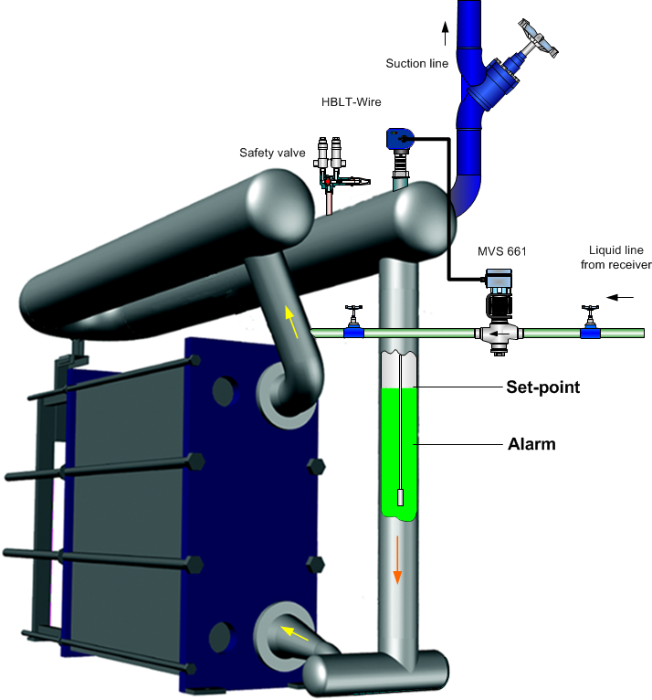
Measuring points:
Programmable:
Set-point: 0-90 %
Alarm point: 10-100 %
20 mA / 100%
4 mA / 0%
P-regulation in Alfa Laval plate heat exchanger

Slide 9
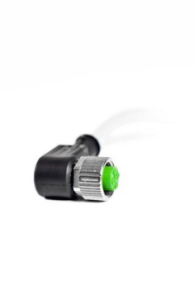
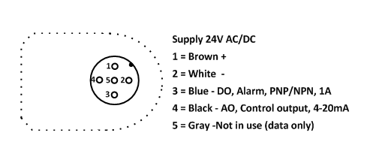
Electrical connections:
Delivered with 5 m cable with M12 plug on one end – flying leads on the other end.
Pin 1 / 2: Power supply – 24 V AC/DC
Pin 4: (AO) – 4…20 mA linear or P-regulation of valve
Pin 3: (DO) – PNP – NO/NC
Pin 5: Not used (communication)

Slide 10
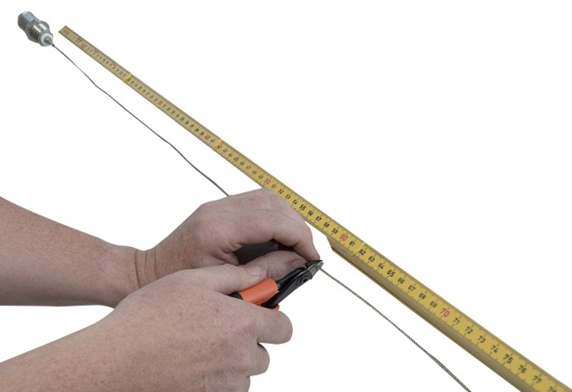
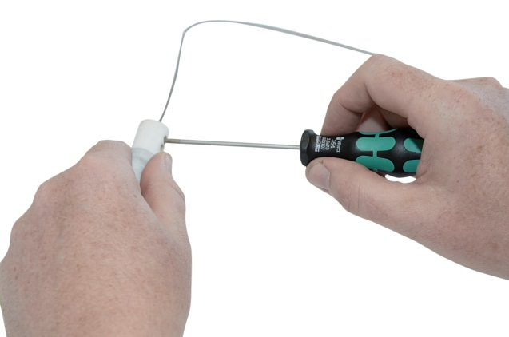
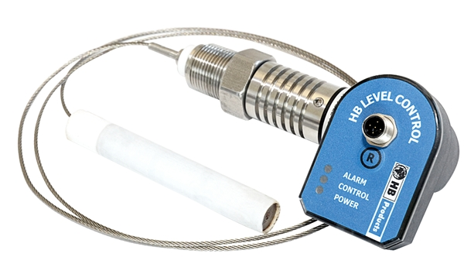
Cut & configure:
Tools required:
Adjustable wrench
2.5 mm hex key
Wire cutter
Tape measure

Slide 11
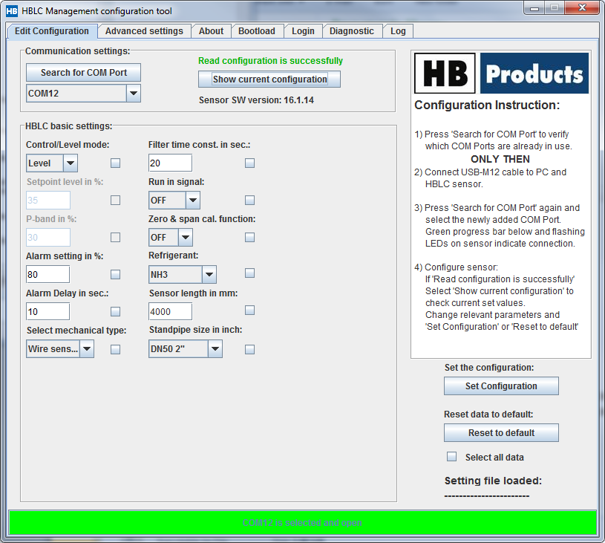
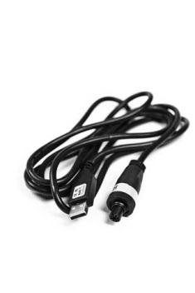
Cut & Configure:
Tools required:
HBLC Tool (from website)
HBxC-USB (prog. Cable)
1) Sensor refrigerant should be input here
2) Sensor length should be input here
3) Enter the standpipe diameter here
4) Save by clicking “Set configuration”

Slide 12
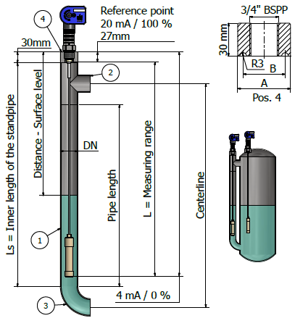
Installation in a standpipe:
Installation guidelines:
Shut-off-valve recommended
Isolation of pipe recommended
Items / measures | DN40 (Ø48,3x2,6)
Tee (2) | DIN 2615-1
Bending 90°(3) | DIN 2615-1/Type 3
Welding connection (4) | Ø48,3x30 mm
Refrigerant | R718, R717, R507, R410, R134, R22
Max pressure | 53 bar
Pipe standard | DIN 10220
Pipe length (1) | L+114
Centerline | L
Welding connection - A | Ø48,3
Welding connection - B | Ø38,3

Slide 13
Benchmark – Level sensors for industrial refrigeration
 | RTK | E+H | Hansen | Danfoss | HB Products [Wire sensor]
Refrigerant | R717, R22, R134A | R717, R22, R404A, R410A, R134A | R717, R22, R134A | R717, R22, R404A, R410A, R134A (R744*) | R717, R22, R404A, R410A, R134, R744, R507
Analogue output (AO) | 4-20 mA | 4-20 mA | 4-20 mA | 4-20 mA | 4-20 mA
Digital output (DO) (Alarm output) | No | NO | No | No | PNP, NO/NC (programmable)
P-regulation of valve | No | No | No | No | Yes, programmable by PC
Configuration/Calibration | Trimmer | Yes by HMI, HART or PC | Trimmer | Yes by HMI | Yes by PC
Bus communication | CAN-open (optional) | No | No | No | No
Display standard | No – but LED | No | No | No | No – but LED (LCD coming in 2014)
Display option | No | Yes | Yes | Yes | No
Measuring range | 150…4000 mm | 150…3000 mm | 510…4270 mm | 800…5000 mm | 300…4000 mm
Available length (L) | Can be ordered in any size 150…4000 mm | Can be ordered in any size 150…3000 mm | 510, 760, 1015, 1525, 2030, 2540, 3050, 3660, 4270 & custome lengths | Can be cut in any size 800…5000 mm | Can be cut in any size 300…4000 mm
Protection degree | IP65 | IP65 | IP65 | IP67 | IP65
Connection thread type | 1” RG | ¾”NPT, ¾”BSPP, 1”NPT, 1”BSPP | ¾” NPT | ¾”NPT & 1” BSPP | ¾”NPT, 3/4BSPP
Dead zone (bottom) | 0 mm | 0 mm | 16 mm | 115-240 (90) mm | 0 mm
Split design | No | Yes | No | Yes | Yes
Shipping size – l:1000 mm | 160x10x10cm-w: 10 kg | 130x15x15cm – W: 6 kg | 150x10x10 cm – w: 6 kg | 19x24x33 cm – w: 2,2 kg | 9,5x9,5x32 cm – w: 1,1 kg
Shipping cost – Denmark/Spain – l:1000 mm | 60 Euro | 47 Euro | 47 Euro | 36 Euro | 22 Euro
Installation height required | 420 + L | L+150…1000+230 mm | 337 + L | 220 mm | 155 mm
Standpipe size | Ø114 mm | ? | 3” (Ø76,2 mm) | 2-4” (Ø50,8-101,6 mm) | 1 ½” (Ø48,3 mm)
Require preparation before installation | No | Yes | No | Yes – approx 30 min | No – can be ordered in fix length at no extra cost
Required accessories for set-up and price | No | No | No | HMI Display | Only for special situations - Free software tool + programming cable (50 Euro)
Require 0% calibration | No | Yes | Yes – if not 3” standpipe and R717 | Yes – for dead zone 90 mm | No – Plug and play
Require 100 % calibration | No | Yes | Yes - if not 3” standpipe and R717 | No | No
Usable in marine installation | Yes | Yes | Yes | No (only with reference pipe) | Yes
Cable included | No | No | No | No | Yes – 5 m
Require special skills | No | Yes to some extend | No | Yes to some extend | No

