Slide 1
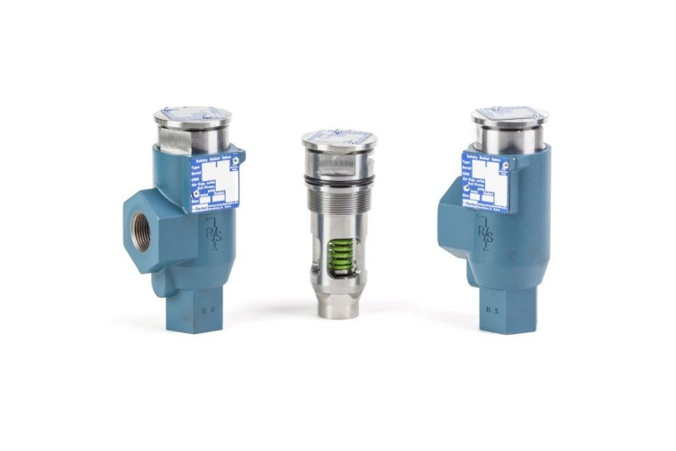
Real Solutions Product Introduction
Cartridge Safety Relief Valve - CSRV

Slide 2
CSRV Overview
CSRV is an evolution of the SRV series of safety relief valves
Cartridge based design
Drop in replacement for SRV
Available in various configurations

Slide 3
Features and benefits
Save money – the cartridge based design results in easier valve replacement
The housing stays installed while the cartridges are swapped out
No need to re-pipe

Slide 4
Features and benefits
Stay safe – stay protected even during maintenance operations
The dual CSRV + maifold combination allows the system to remain protected while the cartridges are swapped out

Slide 5
Features and benefits
Save time – the CSRV will save you time
No need to re-pipe during maintenance
No need to re-pipe during an upgrade
Cartridge replacement takes less than 5 minutes
During the next maintenance interval upgrade to the CSRV and decrease your costs

Slide 6
Safety Relief Basics
Used to prevent overpressure situations
Safely vent or re-direct refrigerant in the case of a overpressure situation
The mechanical equivalent of a fuse
Rated based on capacity (flow) and connection size
Available for liquids or vapors (CSRV is vapor only)

Slide 7
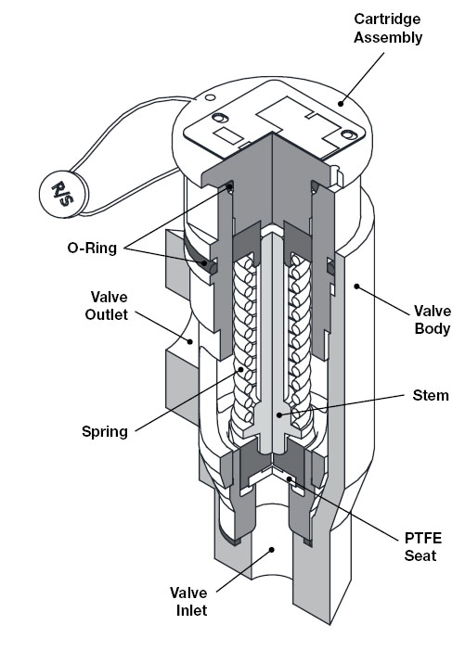
Safety Relief Basics
Precision machined moving parts
Stainless Steel cartridge
Will not cold weld or corrode
Designed to open at a specific pressure

Slide 8
CSRV Selection
Valve | Inlet | Outlet | Pressure Setting | SCFM (air)
CSR1 | ½” | ¾” | 150-400 | 130-290
CSR2 | ½” | 1” |  | 246-622
CSRH1 | ½” | ¾” |  | 463-1173
CSRH2 | ½” | 1”
CSRH3 | ¾” | 1”

Slide 9
Selection Criteria
Safety relief valve should be set below design working pressure of the vessel
Safety relief valve should be set at least 25% higher than the normal operating pressure of the system
Pressure limiting devices should be set at less than 90% of the safety relief setting
Follow all local rules and regulations!

Slide 10
Capacities
Per ANSI/ASHRAE 15 the discharge capacity is determined by:
C = F * D * L
C = capacity in lbs/min
F = 0.5 for NH3
D = Outer diameter of vessel
L = Length of vessel

Slide 11
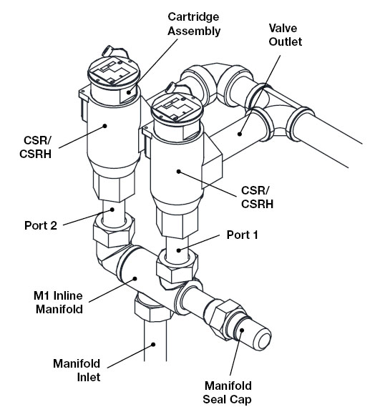
Typical Installation

Slide 12
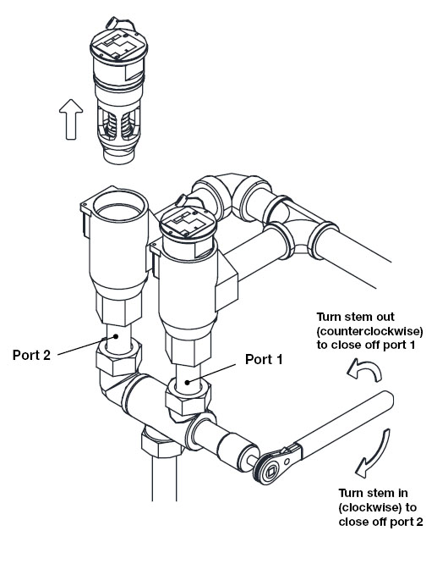
Cartridge Replacement
45-50 ft-lbs

Slide 13
Summary
The CSRV is a proven extension of the SR series
The cartridge based design allows for easier maintenance
The CSRV will save you time
The CSRV will save you money
The CSRV will keep you safe

Slide 14
Questions?

